Slide 1
Goals this Week
1. Finish your MySQL assignment
2. Start working on your CMS assignment

Slide 2
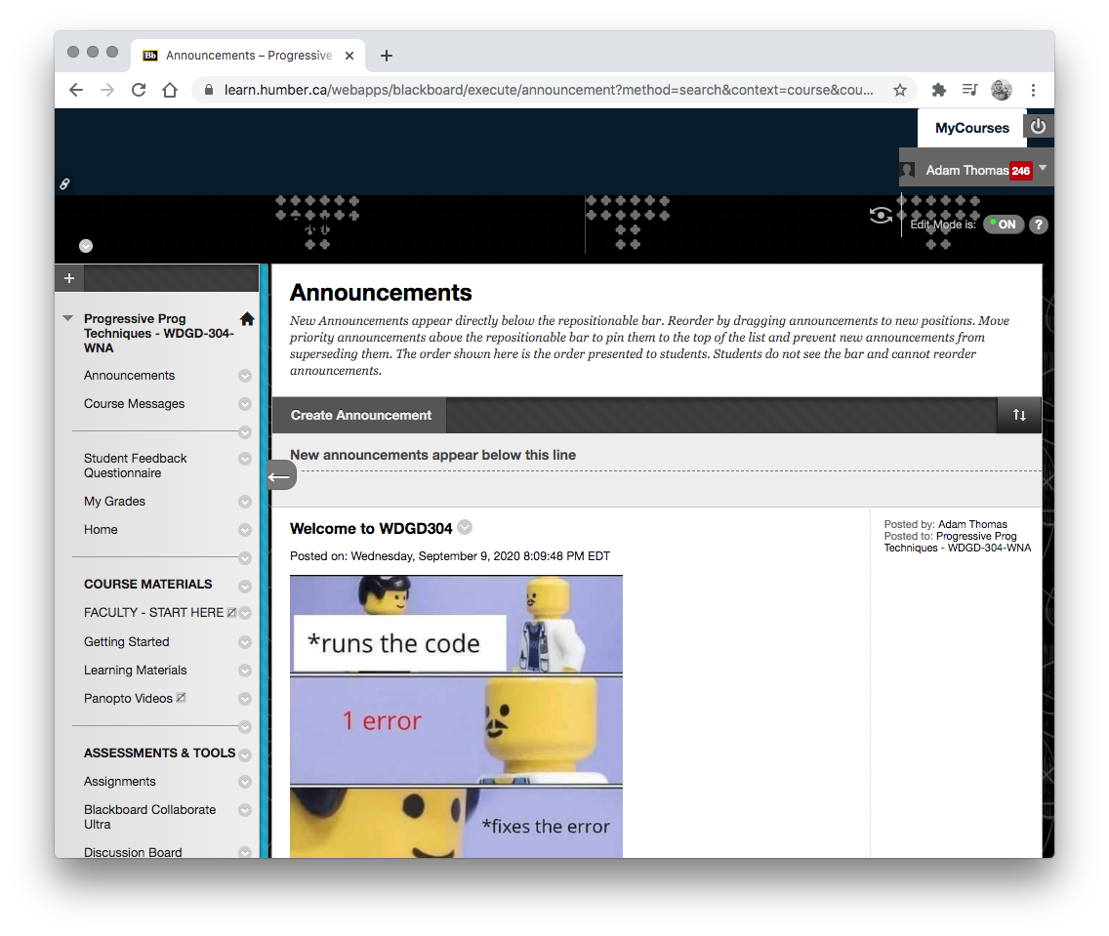
1. Assignments

Slide 3
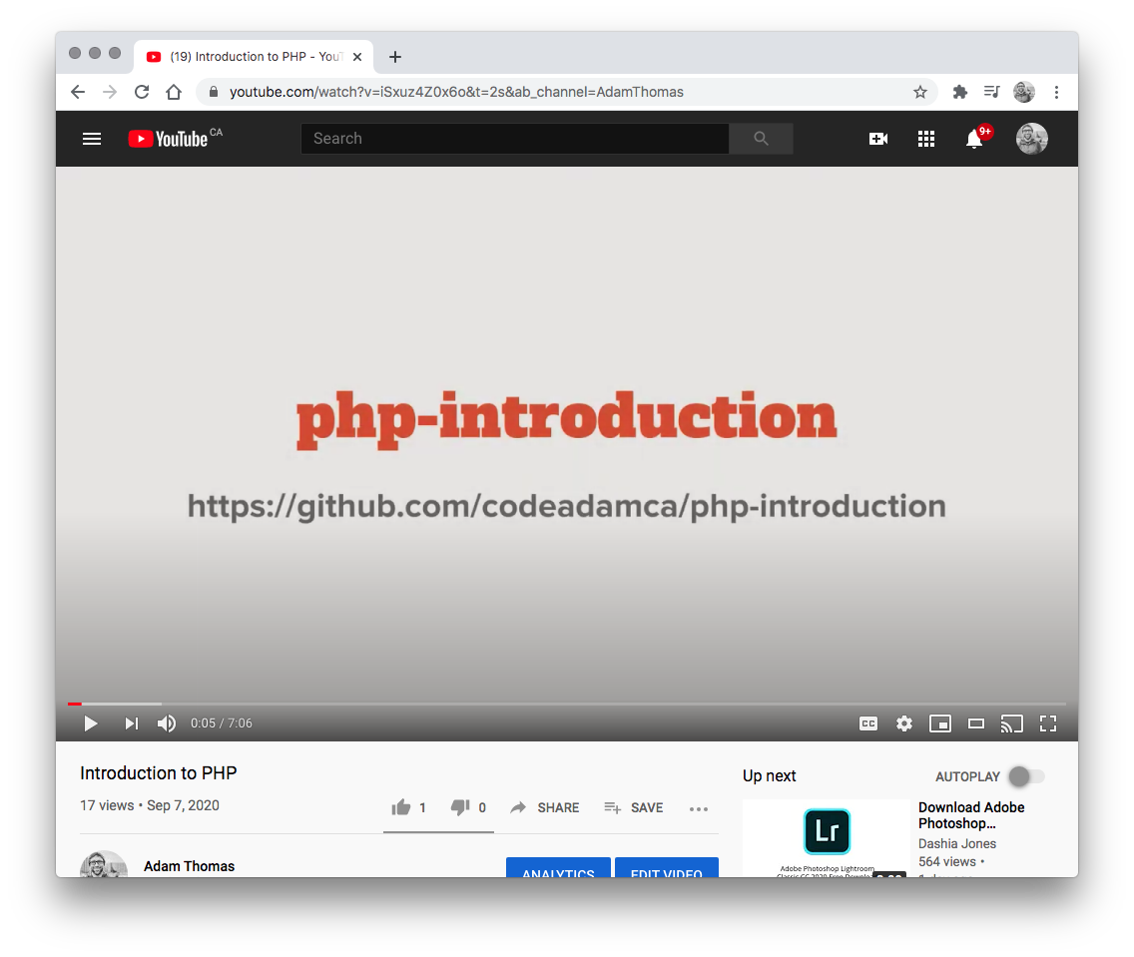

2. Videos
Create a Custom CMS
Creating a PHP CMS - Step 1 - Creating MySQL Tables https://www.youtube.com/watch?v=JO6RB-EDhYI
Creating a PHP CMS - Step 2 - Creating Asset Files https://www.youtube.com/watch?v=_y11vhhtIOA
Creating a PHP CMS - Step 3 - Adding a Basic Login Process https://www.youtube.com/watch?v=dK7JqYRicw4

Slide 4
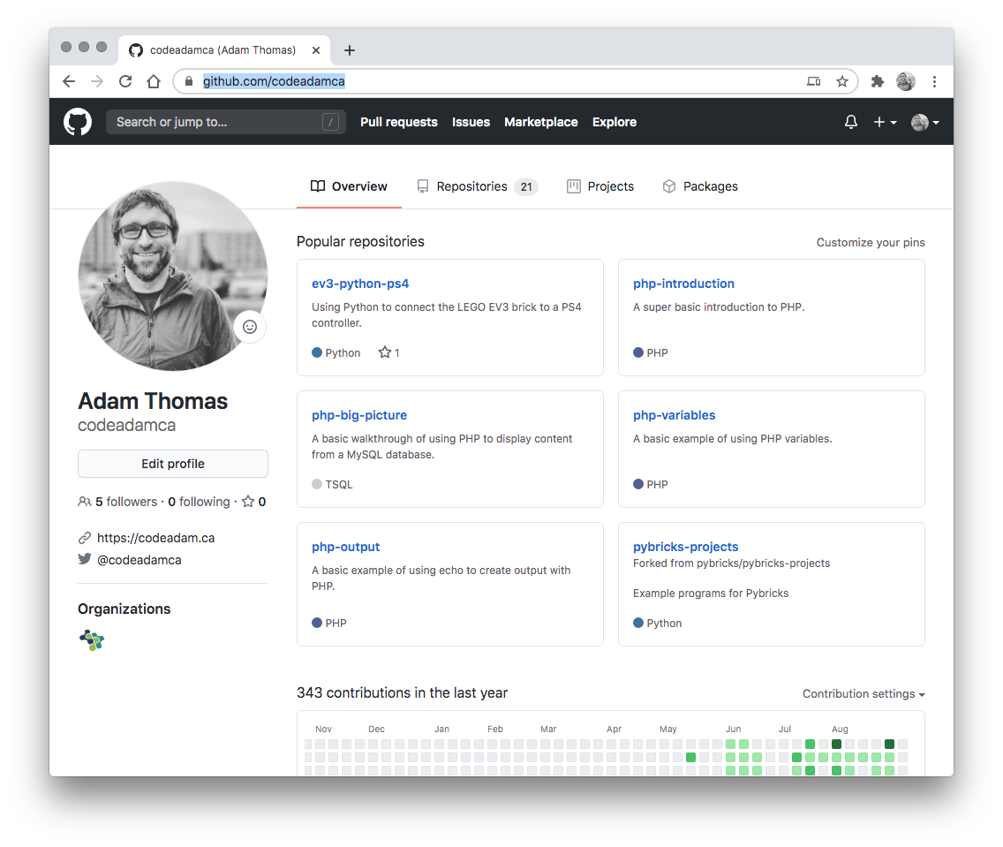

3. Review Code
Review the provided code and follow along with any coding instructions in GitHub:
PHP CMS https://github.com/codeadamca/php-cms

